Slide 1
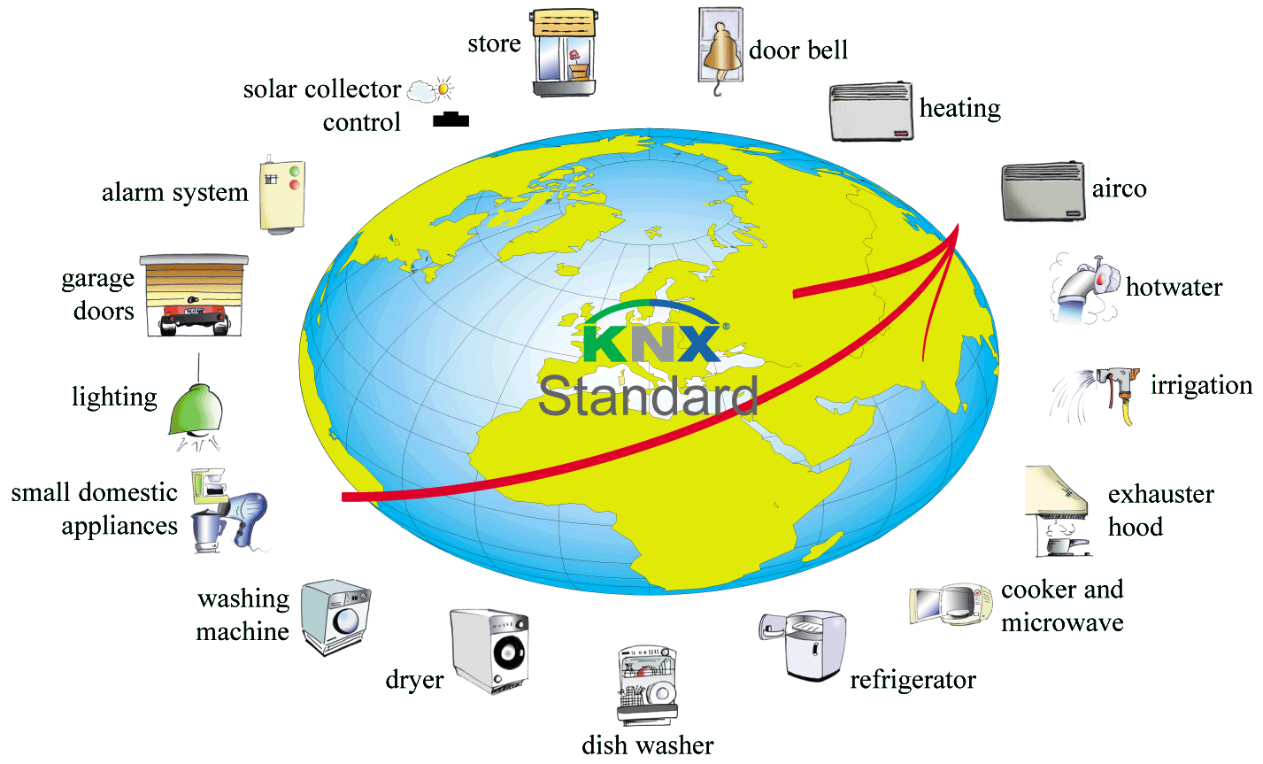
KNX
« While autonomous consumer goods may get by with plug-and-play, distributed applications like lighting, shading, heating and cooling must be designed and configured to suit the requirements of each individual home or office. »

Slide 2
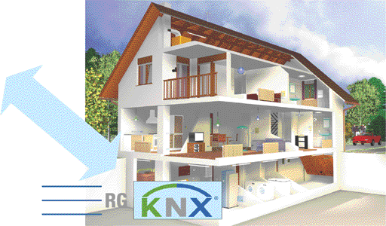
KNX: makes horizontal and vertical integration possible
Service Providers:
Service / Maintenance
Security / Surveillance
Remote Meter Reading
Healthcare /Services
...
Media:
Electricity distributors
Telecom providers
RF
Satellite
Broadband network
Telephone network
Power-line carrier
RG = Residential Gateway: “the electronic door“

Slide 3
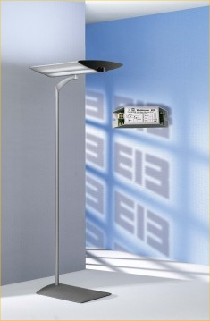
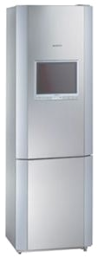
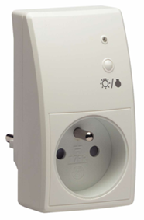
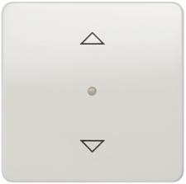
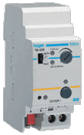
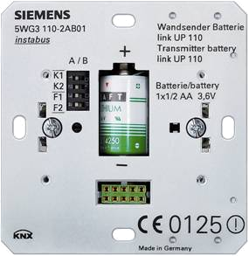
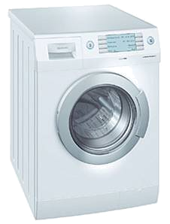
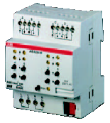
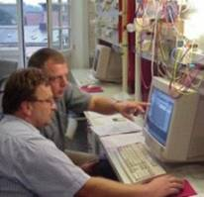
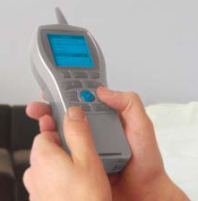
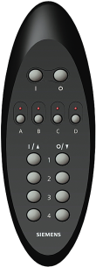
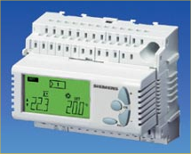
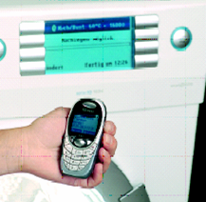
The KNX Configuration Modes
■ Our answer to a variety of real-world needs.
PC-based
Master
Device
Local
(Touch)
Local
(TAG)
Auto

Slide 4
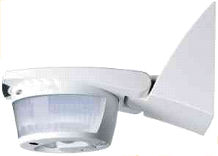

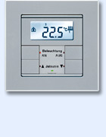
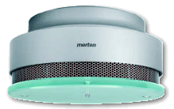

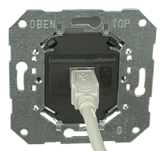
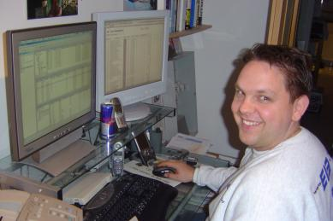
System (“S”) mode for PC-based configuration with common ETS software
A
A
B
import “product libraries” (A, B, C, ...) from product vendors
design required configuration for entire project off-line
configure installation by on-line download
C
C
ETS
B
[identify / discover device]
[load executable application]
[load application parameters]
[load bindings]
PC-based
Master
Device
Local
(Touch)
Local
(TAG)
Auto

Slide 5
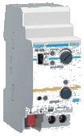
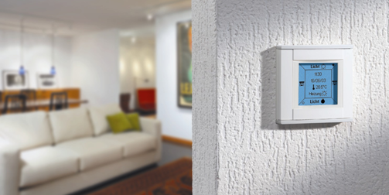
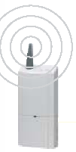
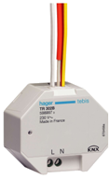
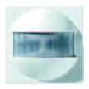
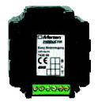

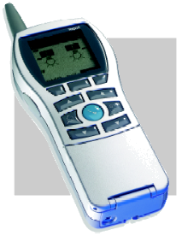
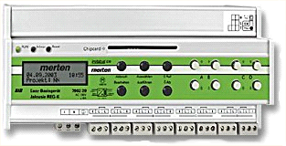
Easy (“E”) Controller Mode with Master device
activate Master to “acquire partner devices”
[search devices]
connect / activate further devices one by one (Master learns!)
[identify / discover device]
link channels (via Master menu or by “touching” devices)
[load bindings]
tune parameters (via Master menu)
[load parameters]
Master (“Controller”)
Master (“Controller”)
PC-based
Engineering
Master
Device
Local
(Touch)
Local
(TAG)
Auto

Slide 6
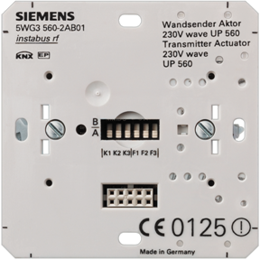
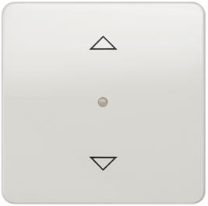
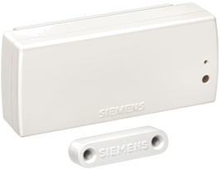
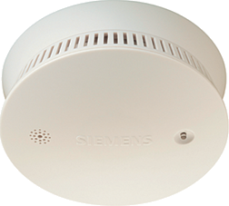
Easy (“E”) Push-button Mode = peer-to-peer touch-to-link
for each intended link:
activate actuator to “acquire” sensors as “partner devices”
touch appropriate sensor to be “enrolled”
→ [set up link (on sensor’s request)]
PC-based
Engineering
Master
Device
Local
(Touch)
Local
(TAG)
Auto

Slide 7
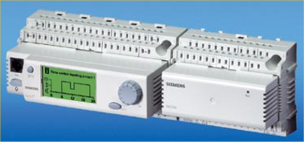
KNX Logical Tag Extended (“LTE”) mode = advanced on-device configuration
fan coil unit
for each device:
boiler unit
(connect HMI interface to device if not present)
assign semantical or geographical zoning tag
tune device / application parameters
hot water valve positioner
air valve
positioner
also permits configuration with ETS!
ETS
→LTE = a compatible extension to the KNX system
PC-based
Engineering
Master
Device
Local
(Touch)
Local
(TAG)
Auto

Slide 8
KNX LTE - mode
LTE was especially designed to accommodate specific HVAC requirements, supporting:
  maximal static application model (to permit on-device configuration without tool)
  in possibly medium-size, low-engineering installations
  using advanced HVAC models
the chosen tag combines with static device characteristics to fix the role of the device in the “maximal run-time application model”
Extended group address accomodates tags in run-time communication.
ETS
For usage in large installations:
alternatively permits PC-based engineering with ETS!
“this is the
room temperature sensor
for room 3
in appartment 2”
“this is the
room temperature controller
for room 3
in appartment 2”
model
tag
tag
PC-based
Engineering
Master
Device
Local
(Touch)
Local
(TAG)
Auto

Slide 9
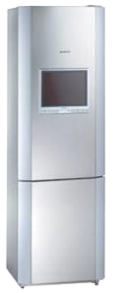
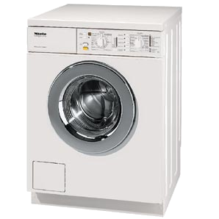
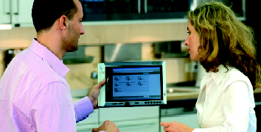

Automatic (“A”) mode = peer-to-peer plug-and-play
plug each device ...
[device acquires address]
[announces itself on network]
[interested communication partners may discover newly plugged device]
[interested communication partners may build links with newly plugged device]
→ realization today as “EHS”
PC-based
Engineering
Master
Device
Local
(Touch)
Local
(TAG)
Auto

Slide 10

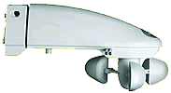
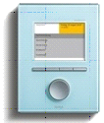
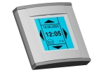
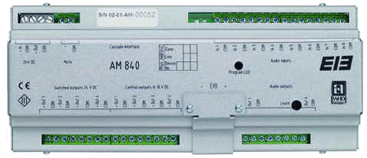
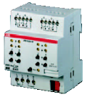


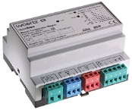

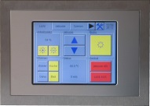
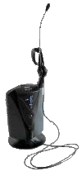
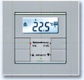

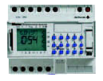

KNX Communication Architecture
Run-time
Configuration & Life-cycle (Servicing)
Run-time AL
Management AL
Core Model
(Publisher / Subscriber Datapoints)
Resources
Model
(handler)
Service API
(apci’s + payload)
Appl
NL
Dedicated Resource Handler
Multicast API
“Communication Object”
Datapoints
Identification + Discovery
AL
LL
Dedicated API
Shared
TL
PL
Generic Resource Model
object.property
stream (file)
Generic API
Use-Case Extensions
Platform Resource Pool
(“Raw”)
ETS
LTE
RF
IP
Communication Services
IP
Multicast
Broadcast
Point-to-point
Port No. 367; IP- MA 224.0.23.12
(assigned by IANA)
Transport Layer
Use-Case Extensions
Network Layer
LTE
RF
UDP
TCP
Link Layer
Media
(R)ARP
ICMP
BootP/DHCP
IGMP
KNX
Twisted Pair
KNX
Powerline
KNX
Radio Freq.
Ethernet
WLAN

